Slide 1

Da Vinci PCT Phase 2
Diagrams

Slide 2
Da Vinci (PCT) – GFE Coordination Workflow
Requester searches/retrieves identifiers of participating providers from the CP.
Requester creates Coordinating Task and Provider Tasks that contain the information necessary to create an estimate.
Participating providers are notified of the new task.
Participating provider retrieves task and updates it to accept or reject.
Notifications of task updates are sent to the requesting provider, including a change to a reject status and potentially a reason why.
When notified of a reject status, requesting provider can create a new provider task for a different provider. Alternatively, the requesting provider can cancel the entire request and if appropriate create a request (with new task resources). This may be done in cases of a scheduling conflict.
Participating provider updates the task with a GFE Bundle and updates the status
Requesting provider can retrieve the full GFE Collection Bundle from the CP at any time. They may choose to close the request. Optional to have the CP deliver the GFE Collection Bundle.
GFE Coordination Requester
Coordination Platform
GFE Contributor
Identifies Co-Providers
1
Submits Request for Estimate via Task resources
2
Send Notification of Task
3
Retrieve and update Task
Accept/Decline participation in GFE collection
4
5
Notification of Task updates
6
Replace Co-Providers
7
Submits GFE(s) and update task
8
Retrieve GFE Collection Bundle

Slide 3
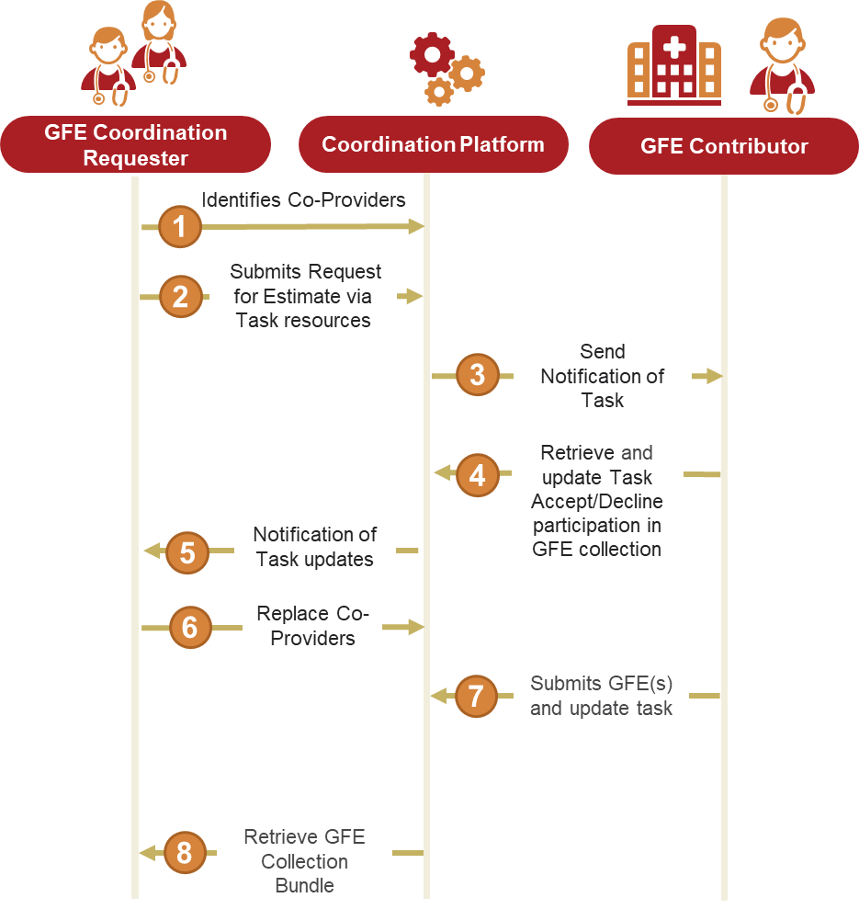

Slide 4
GFE Coordination Request Structure
GFE Coordination Bundle
(type = transaction)
Submitting as a bundle is recommended, but not required.
All Organization and Practitioner Resources pointed to by Tasks reside on the Coordinating Platform.
Provider Specific GFE Request Information Bundles (information and context about what is being requested) can be contained in the Task.input (preferred) or references a Bundle that is stored on the Coordination Platform (or being written to through the Request Bundle).
Requester (Practitioner/Organization)
GFE Coordinating Task
GFE Request Information Bundle
General
GFE Contributor Task
GFE Contributor Task
GFE Contributor Task
GFE Request Information Bundle
Provider Specific
GFE Request Information Bundle
Provider Specific
GFE Request Information Bundle
Provider Specific
GFE Contributor
(Practitioner/ PractitionerRole/Organization)
GFE Contributor
(Practitioner/ PractitionerRole/Organization)
GFE Contributor
(Practitioner/ PractitionerRole/Organization)

Slide 5
GFE Coordination Request Structure
GFE Coordination Bundle
(type = transaction)
Coordination Platform
Submitting as a bundle is recommended, but not required.
All Organization and Practitioner Resources pointed to by Tasks reside on the Coordinating Platform.
Provider Specific GFE Request Information Bundles (information and context about what is being requested) can be contained in the Task.input (preferred) or references a Bundle that is stored on the Coordination Platform (or being written to through the Request Bundle).
GFE Coordination Task
Requester (Practitioner /Organization)
GFE Information Bundle
General
GFE Contributor Task
GFE Contributor Task
GFE Contributor Task
GFE Contributor
(Practitioner/ PractitionerRole/Organization)
GFE Information Bundle
Provider Specific
GFE Information Bundle
Provider Specific
GFE Information Bundle
Provider Specific
GFE Contributor
(Practitioner/ PractitionerRole/Organization)
GFE Contributor
(Practitioner/ PractitionerRole/Organization)

Slide 6
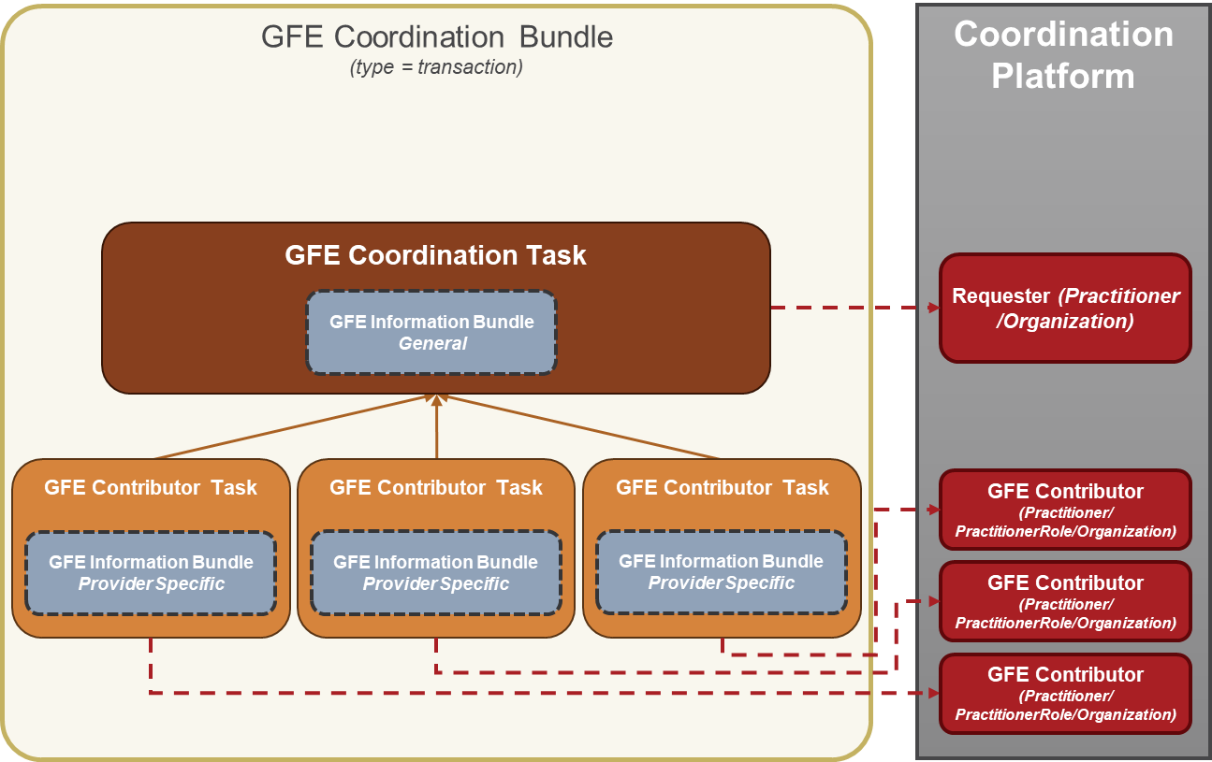

Slide 7
GFE Coordination Request Structure
On Coordination Platform
Submitting as a bundle is recommended, but not required.
All Organization and Practitioner Resources pointed to by Tasks reside on the Coordinating Platform.
Provider Specific GFE Request Information Bundles (information and context about what is being requested) can be contained in the Task.input (preferred) or references a Bundle that is stored on the Coordination Platform (or being written to through the Request Bundle).
Coordination Platform
GFE Coordination Task
Requester (Practitioner /Organization)
GFE Information Bundle
General
GFE Contributor Task
GFE Contributor Task
GFE Contributor Task
GFE Contributor
(Practitioner/ PractitionerRole/Organization)
GFE Information Bundle
Provider Specific
GFE Information Bundle
Provider Specific
GFE Information Bundle
Provider Specific
GFE Contributor
(Practitioner/ PractitionerRole/Organization)
GFE Contributor
(Practitioner/ PractitionerRole/Organization)

Slide 8
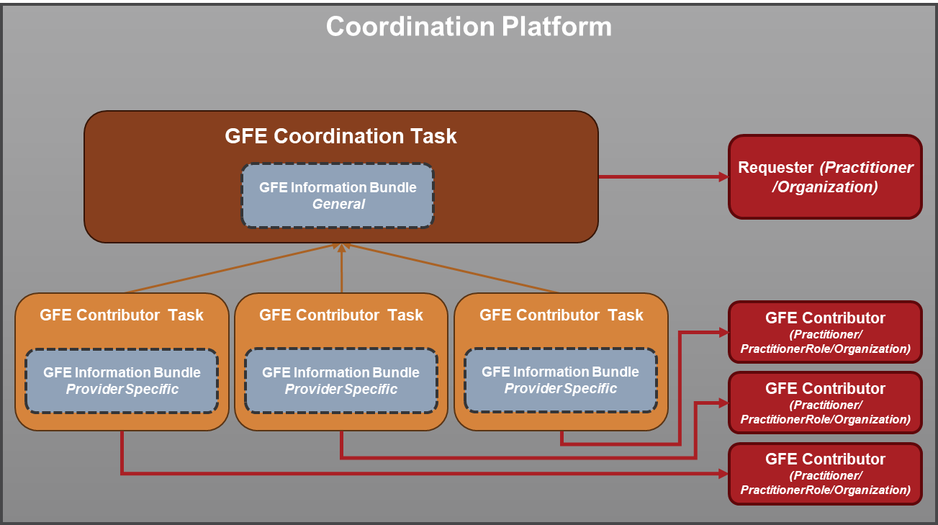

Slide 9
GFE Request Information Bundle
GFE Information Bundle
(type = collection)
Payer Organization is optional
Multiple Organization, Practitioner, or PractitionerRole resources can be indicated
Any combination of request items are allowed as long as there is at least 1 (Should that also be the case for the Provider Specific Task?
DocumentReference attachments are optional
HRex Patient
PCT Coverage
PCT Organization (Payer)
PCT Organization (requested)
PCT Practitioner
(requested)
HRex PractitionerRole
(requested)
(requested-items)
ServiceRequest
ServiceRequest
ServiceRequest
ServiceRequest
ServiceRequest
ServiceRequest
PCT ServiceRequest
PCT MedicationRequest
PCT DeviceRequest
ServiceRequest
ServiceRequest
ServiceRequest
ServiceRequest
NutritionOrder
VisionPrescription
DocumentReference
DocumentReference
DocumentReference

Slide 10
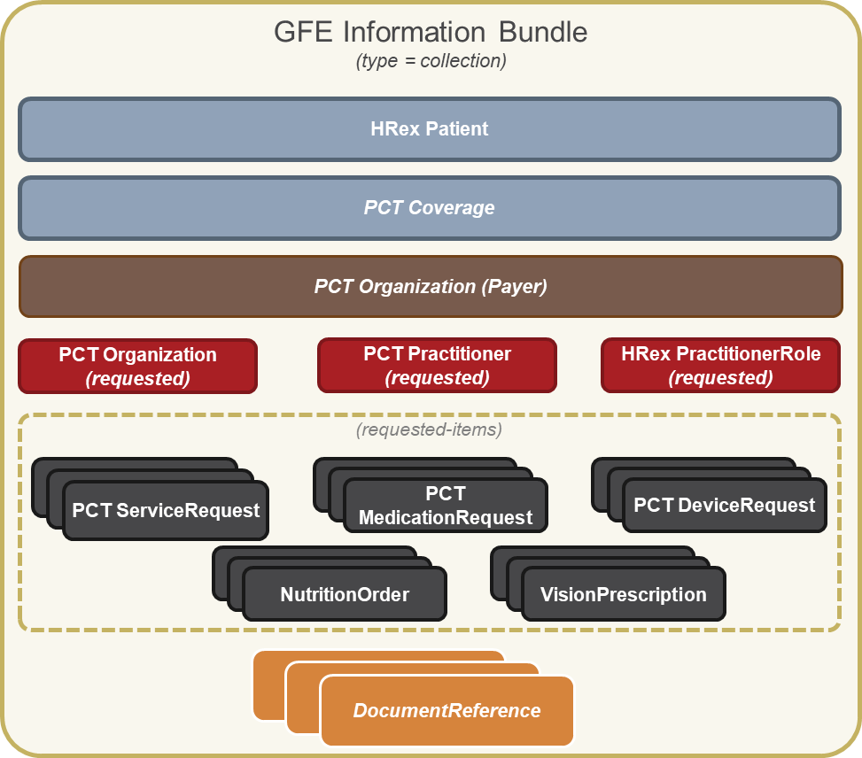

Slide 11
GFE Bundle Structure
GFE Bundle
GFE Missing Bundle
HRex Patient
PCT Coverage
PCT Organization
(Payer)
HRex Patient
PCT Practitioner
(Requested)
or
PCT Organization
(Requested)
Good Faith Estimate (GFE)
Estimated Date of Service
Diagnoses/Procedures
Line items
Product/Service
Quantity/Price
Total
Good Faith Estimate (GFE)
Estimated Date of Service
Diagnoses/Procedures
Line items
Product/Service
Quantity/Price
Total
PCT Organization (Provider)
Good Faith Estimate (GFE) Institutional or Professional Claim Resource
Estimated Date of Service
Diagnoses/Procedures
Line items
Product/Service
Quantity/Price
Total
PCT Organization (Provider)
PCT Organization (Provider)
(requested-items)
PCT Practitioner
PCT ServiceRequest
PCT MedicationRequest
PCT DeviceRequest
PCT Practitioner
PCT Practitioner
NutritionOrder
VisionPrescription

Slide 12
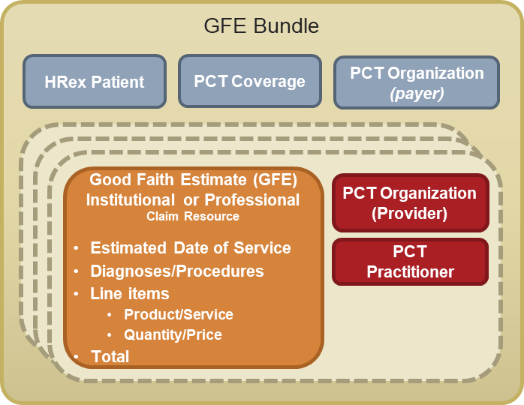
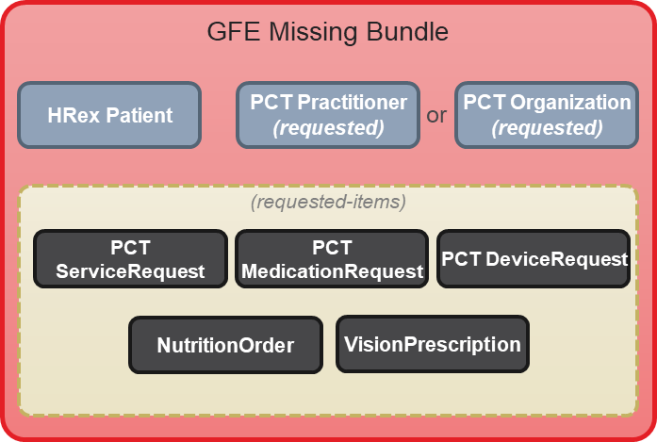

Slide 13
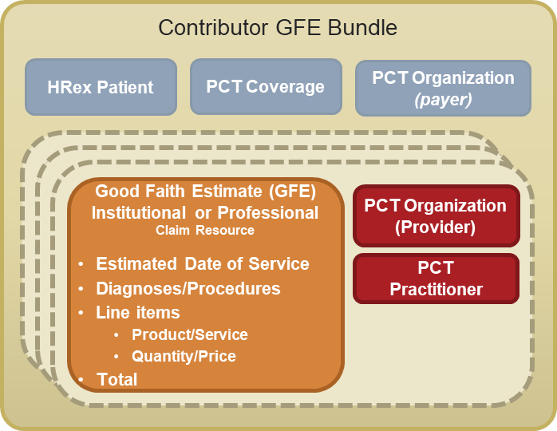
GFE Collection Bundle Structure
GFE Collection Bundle
HRex Patient
PCT Practitioner/Organization
(requester/submitter)
PCT Coverage
PCT Organization
(Payer)

Slide 14
